Slide 1
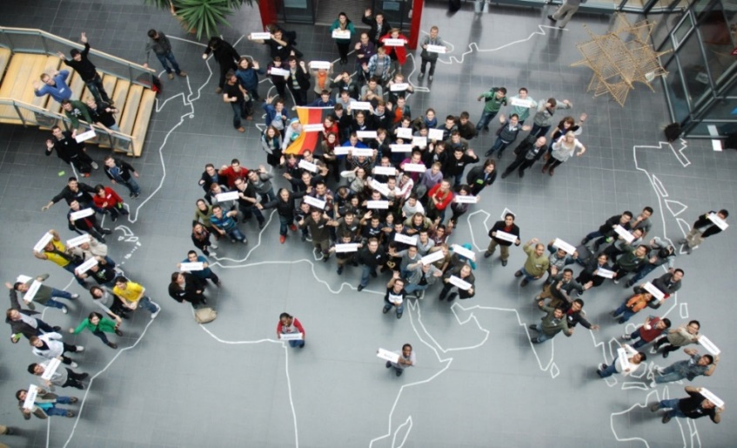
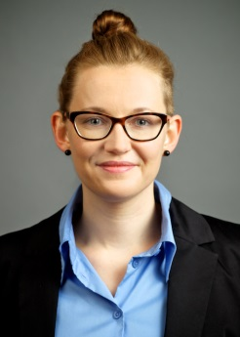
Information for International Degree Students Welcome at TUM Informatics!
Lena Krone
Consultation hours: Mo, 3-5pm
Office: 00.09.037
https://www.cit.tum.de/en/cit/studies/students/advising/informatics/international-student-advising/

Slide 2
1. Enrolment
Health insurance (private vs. statutory / „public“)
Student Card (Student ID, library card, Mensa card...)
Semester Ticket (Deutschlandticket / „Germany Ticket“ / 29 Euro-Ticket)
29 EUR per month
only offered on subscription basis

Slide 3
2. Living in Munich (and surroundings) and Germany
Accomodation (TUM Accomodation Information)
Registration of address (KVR or City hall; „Wohnungsgeberbestätigung“)
Bank account (free checking accounts for students)
Residence permit (proof of sufficient funds)
Broadcasting Fee (mandatory for every residence; „Rundfunkbeitrag“)
Liability Insurance (recommended; „Haftpflichtversicherung“)

Slide 4
3. Help and Support
Student Union („StuWerk“): Advisory Network
Advice for students with children
Legal advice
Psychotherapeutic advice
Scholarship advice
Advice in case of discrimination and abuse
etc.
Medical Care in Germany

Slide 5
4. Learning German / Working in Germany
Learning German:
German courses for all levels offered at the TUM Language Center; registration for German courses in TUMonline
German Matters: special German program for Master‘s students
Fachsprachlicher Deutschkurs C1: special German course for Bachelor‘s students
Other schools offering German Courses: MVHS, Deutschkurse für Ausländer at LMU
Working in Germany:
Two rules: 140 full days / 280 half days per year (non-EU); 20h/week (all students); see information by the Student Union
TUM Career Service

Slide 6
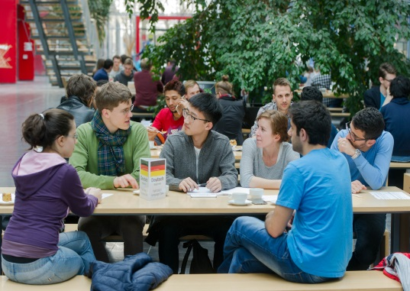
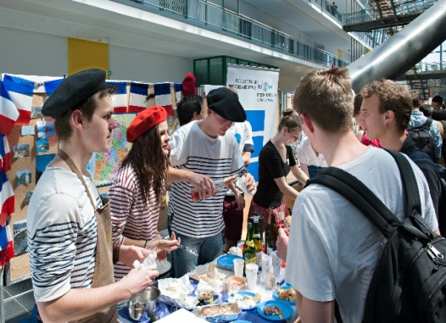
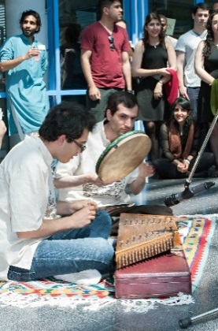
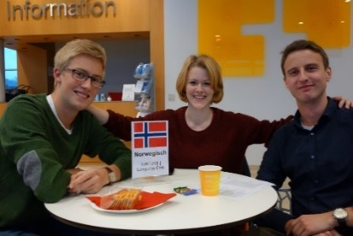
5. Social Events – Making friends
Study Introduction Day (SET) by the Student Council
TUMi: Orientation weeks, Language Café, trips, etc.
Language Café Garching: Wed, 3-5 pm, Magistrale (main hall)
Sports (ZHS – University Sports Center)
TUM Campus Life (student clubs, initiatives etc.)

